Slide 1
Temperature & Humidity Sensor Box
Waleed Binselim
Hoang Nguyen
Stephanie Fernandez

Slide 2
Project Description
For this project, the raspberry pi had to be used to create a building’s heat and humidity profile. This was to be done by using sensors to collect temperature and humidity data and then saving it to a local database. A robust, attention-free, easily deployable system had be created that integrates data from different sources and allows a non-technical user to access the building data at any specified time. A website had to be created to save the data from multiple pi’s to a remote server that authorized persons could log into. The pi’s had to be stored inside of a 3D printed box, and the data from the pi’s had to go into an sqlite3 database. From the database, the data had to be transferred into a website, where the three group members can log onto with different login information. A graph for the individual data profile and stacked curves for the cumulative view needed to be made.
Notes:
Stephanie

Slide 3
Project Goals
The pi’s should be inside a box and be easy to use
The data from the raspberry pi’s should go onto a database
The website should be able to access the database in order to get data
The website should be able to receive data from multiple pi’s
The website should only be accessed by authorized users
New users should be able to create a username and password to access the website
The raspberry pi’s should automatically sync data recorded to the website created
The user should be able to search for temperature and humidity data by date
The website should automatically create individual data profile graph based on searched data
Notes:
Hoang

Slide 4
Component Break Up
Collecting data
Data to database
Login/create user
Database to website
Data to graph
3D printed box

Slide 5
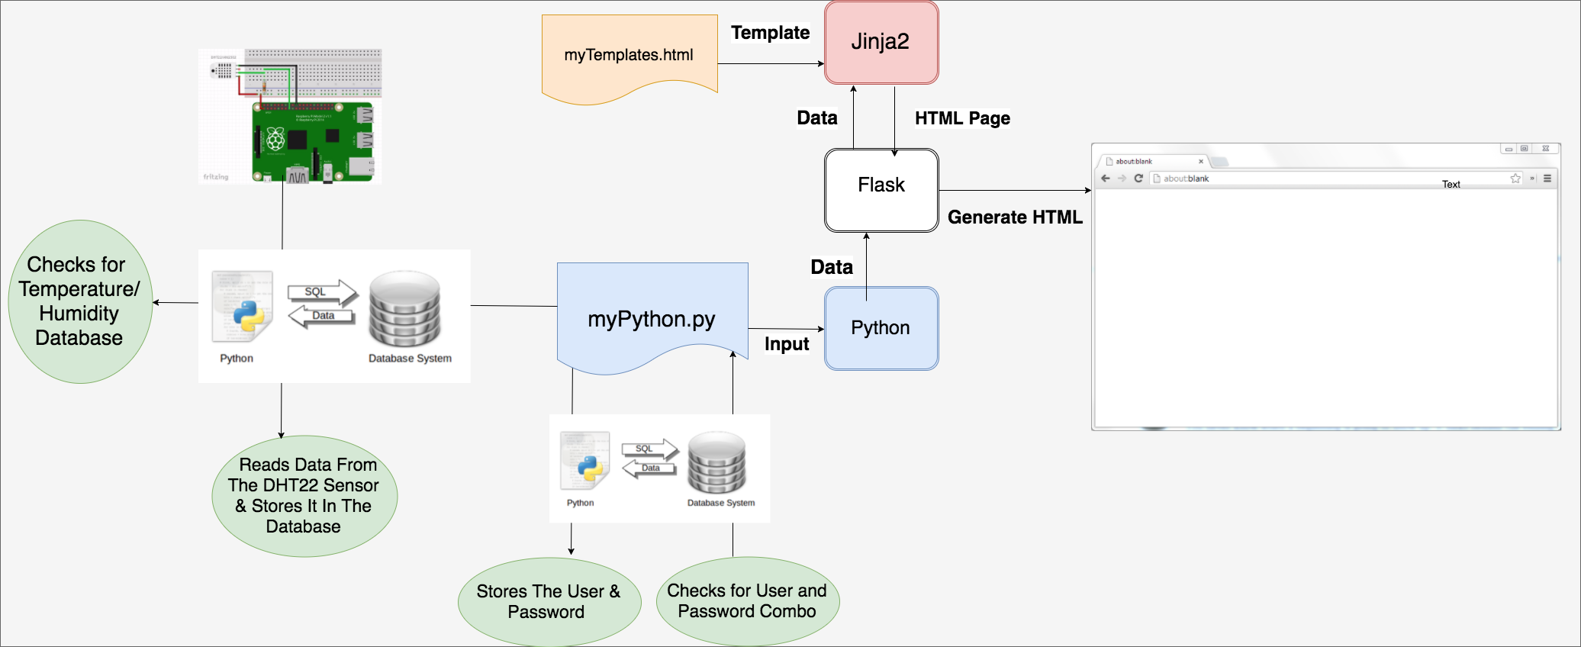
Implementation

Slide 6
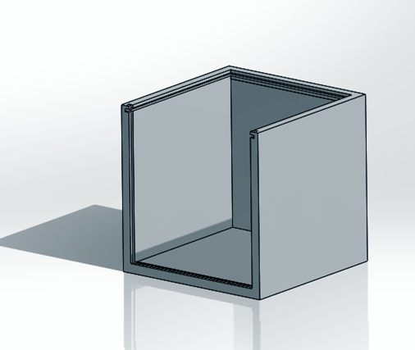
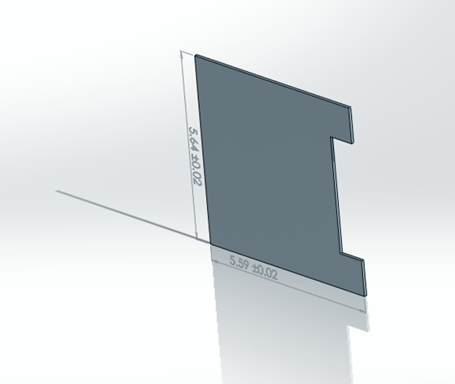
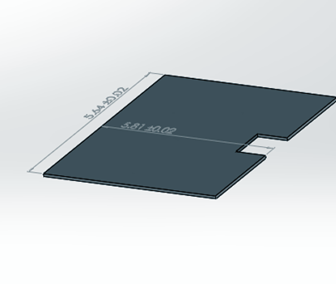
3D Printed Box

Slide 7
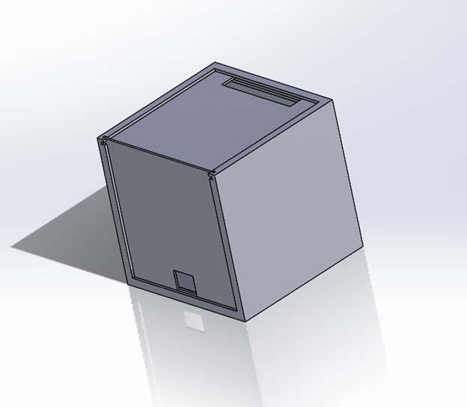

Slide 8
Challenges
“Create user” on website
Automatic graph of data on website

Slide 9
Learning Outcomes
Group work
Time management
Using Raspberry Pi
Python, html, CSS, Flask

Slide 10
Questions?

